Slide 1
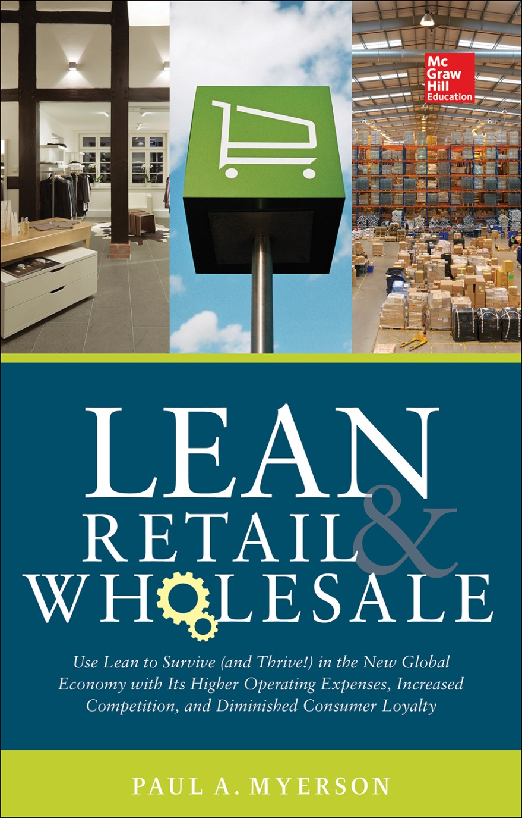
All material used in this presentation comes from the book Lean Retail and Wholesale by Paul Myerson, published by McGraw-Hill, copyright © 2014. All rights reserved.

Slide 2
Agenda
Part I – Current State
Introduction – Using Lean as a Tool to Survive and Thrive in Retail and Wholesale
(R)evolution of Retail – from General Store to e-commerce
The Lean Journey from Goods to Services
Lean Retail and Wholesale – Early Signs of Promise
Part II – Future State
Thinking Lean: Basic Lean Concepts and Tools – Building a Solid Foundation
Thinking Lean: Advanced Lean Concepts and Tools – K.I.S.S. (Keep It Simple
Being Lean: Retail Strategy
Being Lean: Merchandise Management
Being Lean: Store Operations Management
Being Lean: Lean Retail and Wholesale Distribution
Being Lean: Getting Started – Lean Assessments and Value Stream Mapping
Staying Lean: Leadership, Culture, Teams and Training
Becoming Even Leaner: Partnering, Outsourcing, Technology, Six Sigma and Training
Part III – Lean Forward
Lean Forward: Critical Thinking and Continuous Improvement - Methodology, Education, Training and Analytics
Lean Forward: Defining and Measuring Success - Measurements and Current Statistics
Lean Forward: The Way Forward - Thoughts and Suggestions on the Future of Lean in Retail, Wholesale

Slide 3
INTRODUCTION -
Using Lean as a tool to survive and thrive in Retail and Wholesale

Slide 4

Why implement Lean in Retail and Wholesale?

Slide 5

Challenges in Retail and Wholesale

Slide 6

Retail Strategy Viewpoint
Sales & Marketing
Location
Human Resources Management
Information Technology
Supply Chain Management
Customer Relationship Management

Slide 7
Merchandise Management Viewpoint
Planning
Buying
Pricing
Communications

Slide 8
Store and Distribution Operations Viewpoint
Enter
Seek
Find
Select
Transact

Slide 9
The SCOR Model and Lean Retail and Wholesale
PLAN
SOURCE
MAKE
DELIVER
RETURN
RETURN

Slide 10

Making Change Successful
d
SUCCESS
PROCESS
TECHNOLOGY
PEOPLE

Slide 11
(R)evolution of Retail – from the General Store to e-Commerce

Slide 12

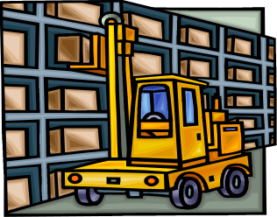
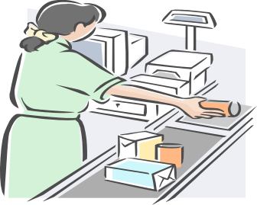
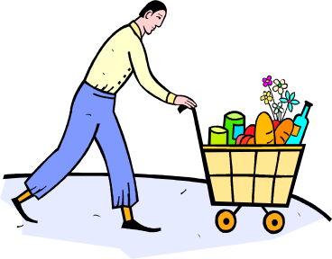
Retail vs. Wholesale
Manufacturer
Wholesaler
Retailer
Customer
Channels of Distribution

Slide 13
Retail and Wholesale Defined
A retailer purchases goods or products in large quantities from manufacturers directly or through a wholesaler, and then sells smaller quantities to the consumer for a profit. Retailing can be done in either fixed locations like stores, markets and door-to-door, or by means of delivery (from a catalog or website).
A wholesaler, on the other hand, is a business that buys large quantity of goods from various producers or vendors, stores and resells them to retailers. Wholesalers who carry only non-competing goods or lines are called distributors.

Slide 14
Retail Classifications and Types
Food products – Includes various food and beverage products.
Hard goods or durable goods - Includes appliances, electronics, furniture, sporting goods, etc. This type of goods doesn’t wear out quickly and provide utility over time.
Soft goods or consumables – Includes clothing, apparel, and other fabrics. These goods are consumed after one use or have a limited time period to use them.

Slide 15
History of Retail
Pre World War II
Retail Growth (1945-1975)
Big Box and Category Killers (1975-1990)
Retail Consolidation (1990-2000)
The 21st Century (2000-Present)

Slide 16
Retail’s Value in the Distribution Channel
Value as a Utility
Form Utility – Performed by the manufacturers (as well as third party logistics companies or “3PL’s” that perform value added activities such as kitting and display assembly) making the products useful.
Time Utility – Having products available when needed.
Place Utility – Having items available where people want them.
Possession Utility – Transfer ownership to the customer as easily as possible, including the extension of credit.
Information Utility – Opening two way flows between parties (i.e. customer and manufacturer).
Service Utility - Providing fast, friendly service during and after the sale and teaching customers how to best use products. This is becoming one of the most important utilities offered by retailers.

Slide 17
Value as an Activity
Assortment – Manufacturers produce a limited number of items whereas supermarkets can carry upwards of 50,000 items. Thus retailers are able to offer a wide assortment of products to consumers at one location.
Sorting or Breaking Bulk – Manufacturers can achieve economies of scale in production and transportation costs by shipping in large quantities. When applicable, wholesalers offer in smaller quantities to retailers and in all cases, retailers offer in smaller quantities to consumers.
Hold Inventory – Retailers hold inventory so that it is readily available to consumers who have limited space in their homes.
Provide Services – Retailers provide value added services such as credit, displays to test, product demonstrations and sales people to answer questions.

Slide 18
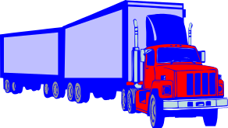
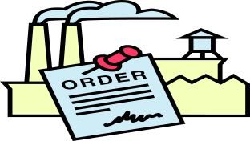
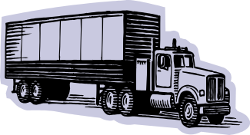

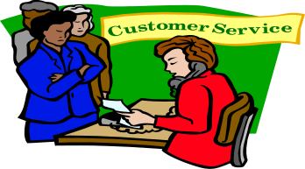
Value Chain
Inbound
Logistics
Operations
Outbound
Logistics
Sales & Marketing
Service
Primary Value Chain Activities

Slide 19
The Lean Journey: from Goods to Services

Slide 20
Evolution of Lean
Artisan
Industrial Revolution
Mass Production
Lean Production
Mass Customization

Slide 21
Manufacturers and Wholesalers Partner with Retailers
Quick Response (QR) is a Just-In-Time (JIT) inventory partnership strategy between suppliers and retailers of general merchandise involving supply techniques that allow retailers to change demand in response to fashion trends and seasonal sales variation.
QR is enabled by technologies such as:
Electronic Data Interchange (EDI) – A standardized format for businesses to exchange data electronically.
Bar Codes – An optical machine readable data relating to the item to which it is attached. Typically, a bar code contains the manufacturer and item code.
Radio Frequency Identification (RFID) – The wireless use of radio frequency (RF) signals to transfer a multitude of data to automatically identify and track tags attached to objects.

Slide 22
Lean Office
Waste is everywhere and that offices shared some of the same characteristics of manufacturing, such as batching, setups, equipment failure, standardized work, etc. In fact, as much as 60 to 80 percent of a product or service lead time can be found in the office environment

Slide 23
Lean Supply Chain and Logistics Management
Virtual
Market
Sensitive
Agile
Supply
Chain
Process
Integration
Network
Based
Foundations for an Agile Supply Chain

Slide 24
Lean Retail and Wholesale – early signs of promise

Slide 25
Plan
Walmart’s Retail Link program, started in 1992, is a system designed to strengthen supplier partnerships. The system provides vendors information on sale trends and inventory levels.

Slide 26
Source/Make
Efficient Consumer Response (ECR) programs were implemented at numerous grocery chains throughout the 1990’s including H.E. Butt, Shop-Rite and Spartan Stores
Quick Response (QR) programs were successfully implemented at numerous Apparel and Mass Merchandisers such as Dillard’s, Kmart, and J.C. Penney
Various pilot CPFR projects which included retailers such as Wegmans, Kmart, Walmart, Target, Tesco, Meijer and Sainsburys achieved 30% - 40% improvements in forecast accuracy, significant increases in customer service, sales increase between 15% and 60%, and reductions in days of supply of 15% - 20%.

Slide 27
Thinking Lean: Basic Lean Concepts and Tools – Building a Solid Foundation

Slide 28
Eight Wastes
T.I.M. W.O.O.D.
unnecessary Transportation (or Movement)
Inventory
excess Motion
Waiting
Over production
Over processing
Defects or Errors
Plus Behavior

Slide 29



Inventory Waste
SCRAP
DOWN
TIME
SETUP
TIME
LATE
DELIVERIES
QUALITY
PROBLEMS

Slide 30
Inventory Waste (cont’d)
Four kinds of inventory:
Raw Materials – Typically purchased
Work-In-Process – The transformation process has started but hasn’t yet been completed
Finished Goods – Finished, saleable product
MRO (Materials, Repairs and Operations) – Inventory for equipment spare parts and supplies
Carrying or Holding Costs – the real cost of inventory
Inventory compensates for variability in your process which cause waste such as
long setups, quality issues, scrap, late delivery, etc

Slide 31
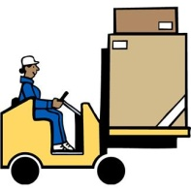
Transportation or Movement Waste
This type of waste can include transporting, temporarily locating, filing, stocking, stacking or moving materials, people, tools or information.

Slide 32

Motion Waste
Have things you use more often, closer to you (and at waist level) and things you use less often, further away and higher up.
Any motion that doesn’t add value to the product or service is wasteful.
Point of Use Storage
Ergonomics

Slide 33

Waiting Waste
Time spent waiting on material, supplies, information and people that are needed to finish a task

Slide 34

Overproduction Waste
Overproduction, and Overprocurement, is manufacturing, ordering or processing something before it is actually needed.

Slide 35

Overprocessing Waste
Where too much time or effort is put into processing material or information that is not viewed as adding value to the customer.

Slide 36

Defect or Error Waste
In Manufacturing, defects primarily refers to repair, rework or scrapping of material.
In the Office and Warehouse, we’re mainly talking more about Errors such as those made during data entry, receiving, picking and shipping the wrong product (or the right product, but to the wrong customer).

Slide 37

Behavior Waste
The need employee creativity and participation to eliminate the other seven wastes

Slide 38
House of Lean
Lean Enterprise
Continuous Improvement
Performance Management
Once Piece Flow
Cellular/Takt
TPM
Pull/Kanban
Kaizen
Quick Changeover
Quality @ Source
Waste
Teams
Standardized
Work
5S/Workplace
Organization
Visual
POUS
Value Stream Mapping
Performance Measurement (Lean Culture)

Slide 39
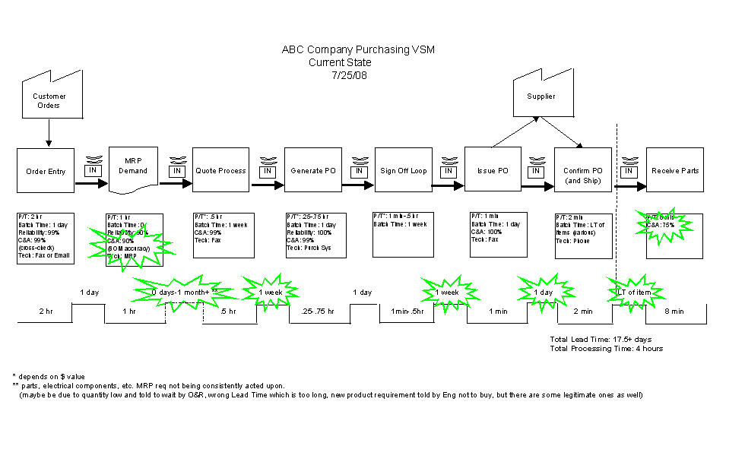
Value Stream Mapping
The “current state” map identifies value added and non-value added activities.
The “future state” map attempts to reduce or eliminate non-value added activities.

Slide 40
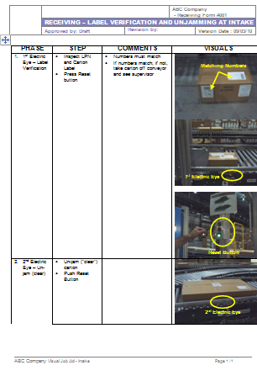
Standardized Work
Standardized Work refers to the standardization of best work practices…as the work is actually done in real life.
The idea is to make work safe and repeatable with as little variation as possible along with high productivity

Slide 41
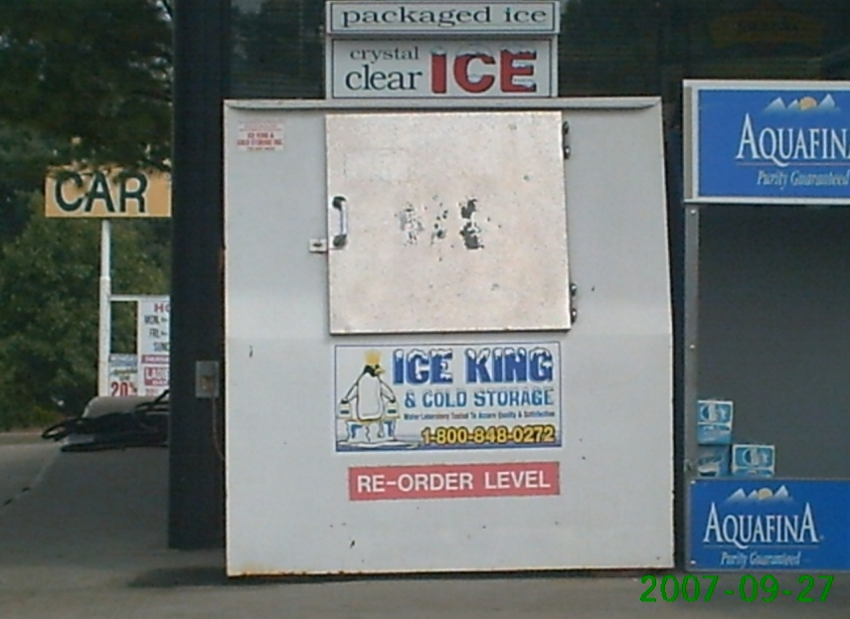
Visual Workplace
Simple visual signals give operators the information to make the right decision.
They are efficient, self-regulating, and worker-managed.

Slide 42

Layout
By eliminating waste in a process, items keep flowing, as opposed to waiting in a queue, in an aisle, etc.

Slide 43

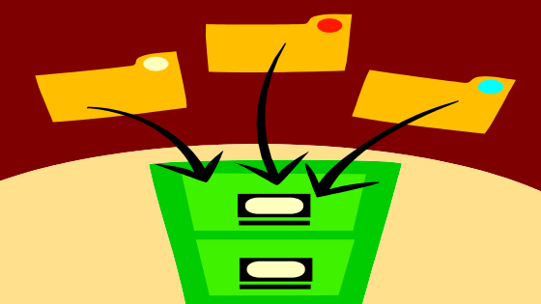
5S – Workplace Organization
Sort Out – when in doubt toss it out
Set in Order – a place for everything and everything in its place
Shine – cleaning as a form of inspection
Standardize - standardize how the first three S’s are maintained
Sustain - habit of maintaining correct procedures over the long term

Slide 44



Batch Size Reduction
JIT Level Material-Use Approach:
A A B B B C A A B B B C
Large-Lot Approach:
A A A A A A B B B B B B B B B C C C

Slide 45
Benefits of Batch Size Reduction
Shorter Lead Times
Quality issues with smaller batches effect less products
Less floor space
Lower amounts of WIP

Slide 46

Quick Changeover
High setup costs encourage large lot sizes
Pit crew analogy – when we’re changing over we’re not producing product
SMED (Single Minute Exchange of Dies)
Changeover is from last good piece to first, next good piece

Slide 47
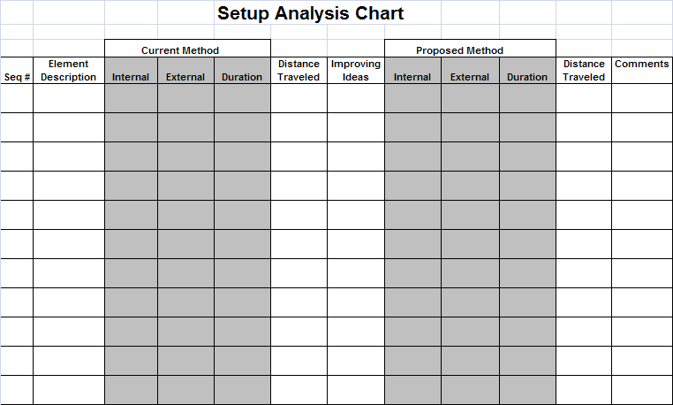
Setup Analysis and Reduction
Some keys to improving a setup are:
Separate preparation or external setup from actual or internal setup and move as much as possible to external so you can shorten the changeover time.
Move material and tools needed for the changeover closer to the actual spot it’s needed.
Standardize the actual process (and combine steps where possible) and tools used.
Train Operators and Mechanics on procedures.
A good tool to do this is to use a Setup Analysis Chart

Slide 48
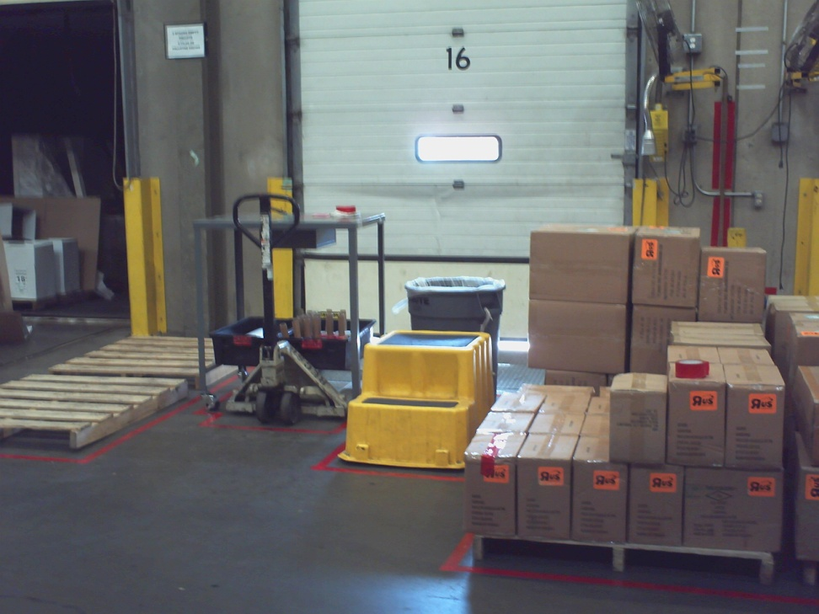
Warehouse and Store Operations Setups
Warehouse Operations setups are found in:
Receiving
Picking
Staging
Loading
Shipping (especially for shift start ups)
Stores can have rough startup as well at the beginning of the day and when changing shifts, especially with the large use of temporary workers. So, standardizing and visualizing store opening and shift changes can make this activity more productive.

Slide 49
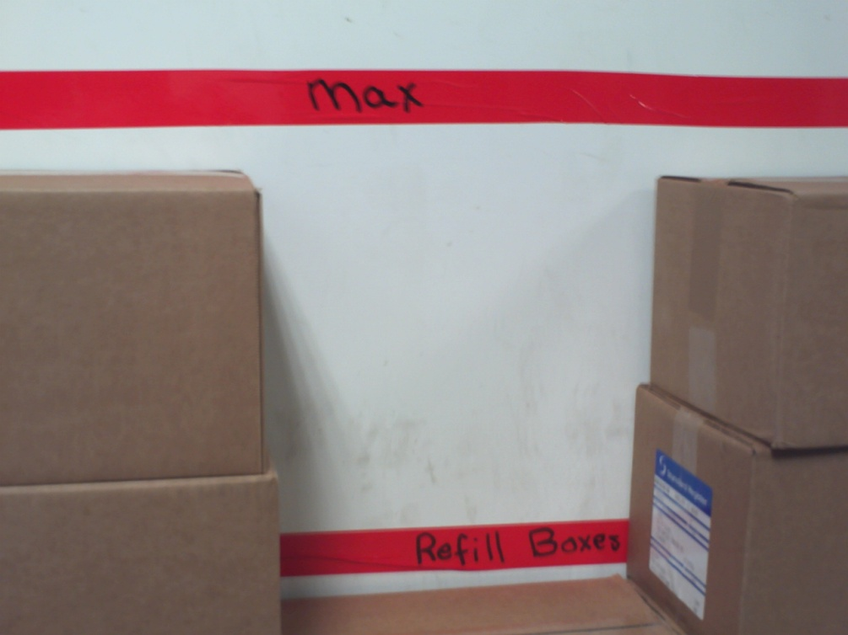
Kanbans
Kanbans are a way to control the flow of materials and other resources by linking functions with visual controls.
Only what has been consumed at the demand by the downstream customer is replaced.
This determines the production and replenishment schedule.
Use the concept of “Point of Use Storage” (POUS)

Slide 50

Quality at the Source
Next step in any process is the customer and you want to make sure that you deliver perfect product to that customer
A way to help ensure this is through the use of “Poka Yokes”. .. a Poka Yoke is a way to make so that it is virtually impossible to pass on a defective part or piece of information from one process to another
Used in conjunction with a Total Quality Management (TQM) program

Slide 51

Workcells
Work Cells rearrange people and equipment that would typically be located in various departments into one group so that they can focus on making single product or service or group of related items or services
Typically in a “horseshoe” type shape which allows for a more efficient use of work space, equipment and is conducive to one piece flow and as a result, less WIP
Important to calculate the Takt time for the product or service family (Total Work Time Available/Units Required) in order to balance the activities in the Work Cell so that materials or information can flow.
Work Cells can be appropriate not only on the Shop Floor, but in the Office and Warehouse

Slide 52
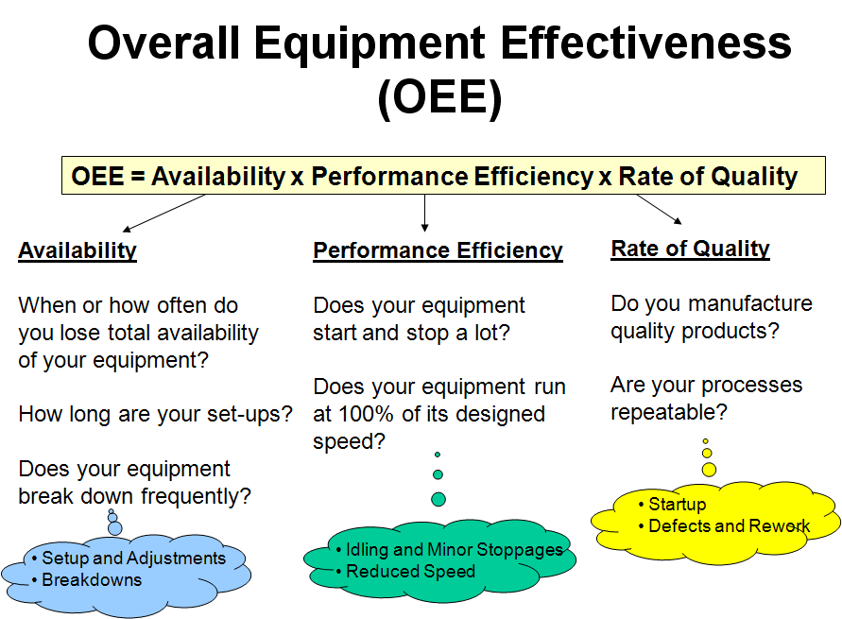
Total Productive Maintenance (TPM)
TPM looks to reduce equipment related waste
Preventative vs. Breakdown Maintenance
Overall Equipment Effectiveness (OEE)

Slide 53
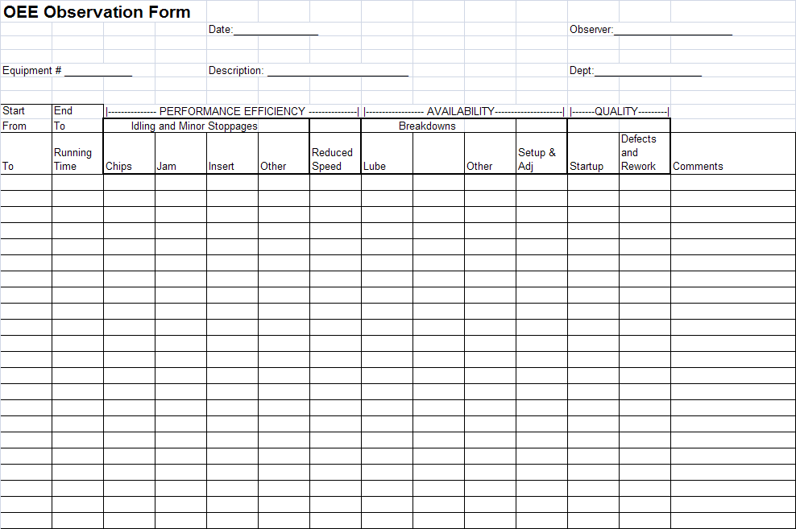
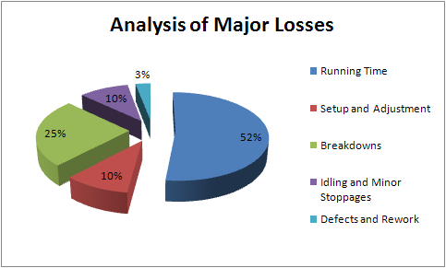
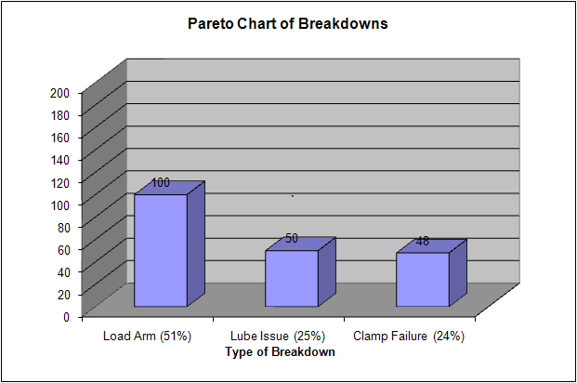
TPM (cont’d)
OEE Observation form used to collect data
Analysis of Major Losses
Pareto Chart of Breakdowns

Slide 54



Lean Analytical Tools
Gathering - Check Sheets, Scatter Diagrams and Cause and Effect
(or Fishbone) diagrams
Organizing - Pareto Charts and Flowcharts
Identifying problems - “5 Why’s”, Histograms and Statistical Process Control (SPC)

Slide 55
Being Lean: Retail Strategy – Sales & Marketing, Location, Human Resources Management, IT, Supply Chain Management, Customer Relationship Management

Slide 56
Retail Strategic Plan
Mission statement
Situation analysis
Set objectives
Obtain and Allocate Resources
Develop the Strategic Plan
Strategy Implementation and Control

Slide 57
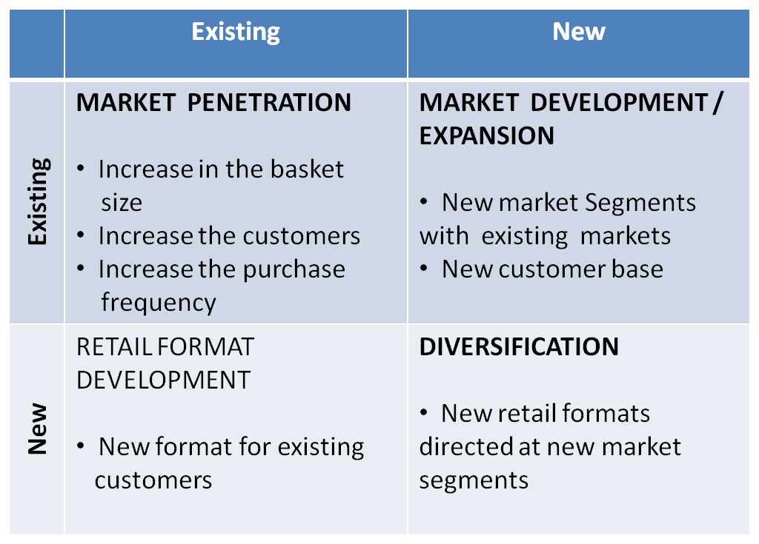
Situation or “S.W.O.T.” Analysis
Product
Market
Ansoff Matrix

Slide 58
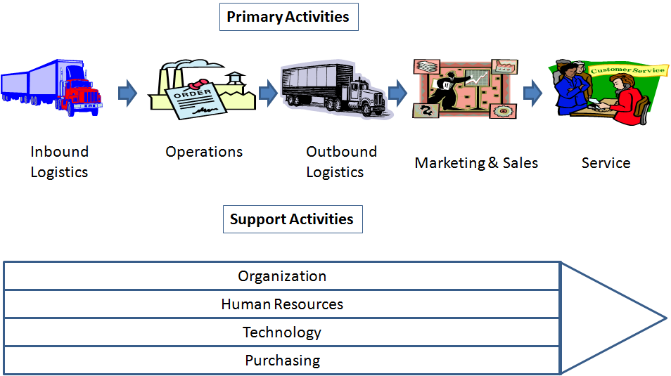
Lean Strategic Focus: Retail Value Chain
Value Chain Model

Slide 59
Marketing & Sales Strategy
Product
Place
Target Market
Price
Promotion
Marketing Mix

Slide 60
The Promotion Mix
Advertising
Publicity
Objectives:
Inform
Pursuade
Remind
Personal
Selling
Sales
Promotion
Promotion Mix

Slide 61
Location Strategy
Checklist Method
Retail Gravity Theory
Retail Saturation Theory

Slide 62
Human Resource Strategy
Labor Productivity
Labor is a large percentage of retail expenses in terms of operations and selling and can contribute greatly to a company’s efficiencies and competitive advantage.
One way to measure labor effectiveness is productivity. In retail this would involve dividing the “output” (sales or profits) by the “inputs” (the number of employees). Lean, when properly implemented, focuses on reducing cycle time and increasing throughput, which in many cases can be accomplished by increasing employee productivity.

Slide 63
Working Together
HR Professionals
Store Managers
Store Employees
Human Triad

Slide 64
Working Together
(cont’d)
Hiring and Developing Employees
Motivating Employees - a happy employee is a productive employee
Empowerment - allowing employees to have input and control over their work, as well as the ability to share suggestions and ideas about their work and the organization as a whole

Slide 65
Information Systems and Supply Chain Strategy
An efficient supply chain can benefit a retailer by giving it a strategic advantage over competitors, improved product availability and greater return on investment.

Slide 66
Retail Information Flow
Customers
Buyer/Planner
Stores
Vendor
Distribution Centers

Slide 67
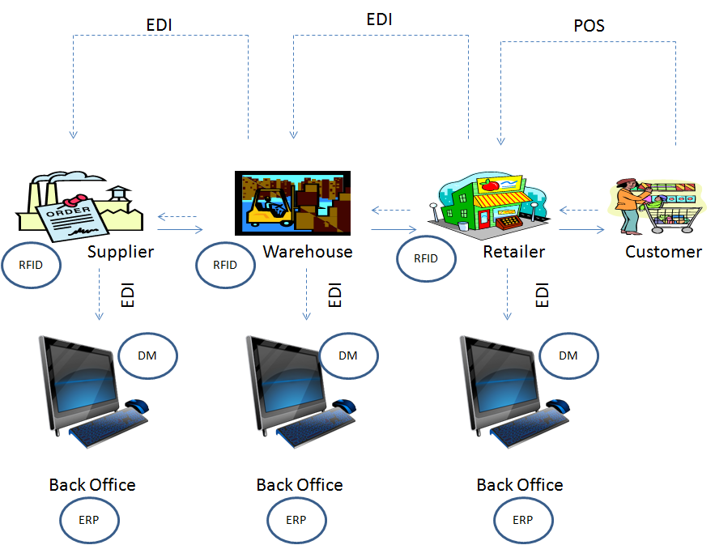
IT in Retail Supply Chain

Slide 68
Retail Merchandise Flow
Customers
Stores
Vendor
Distribution Centers

Slide 69
Customer Relationship Management Strategy
Customer Relationship Management (CRM) is an approach that can assist organizations to serve their customers better.
CRM helps to identify valuable customers, assess their needs, and provide more personalized service to build loyalty. It also streamlines the handling of enquiries and requests, which results in greater operational efficiency and faster responses to customers.

Slide 70
CRM Activities
Collect Customer
Data
Implemrnt CRM Program
Analyze data and target customers
Develop CRM Programs

Slide 71
Being Lean: Merchandise Management - Planning, Buying, Pricing and Communications

Slide 72
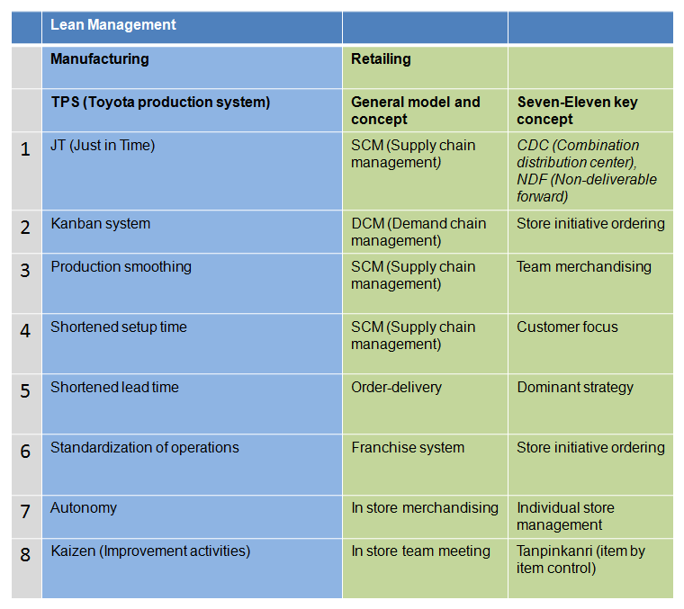
Lean Merchandise Management
Production and Retail Overview to Lean Management

Slide 73
Merchandise Management Process
The major steps in merchandise management entail:
Analysis - Required because a retailer needs to understand the needs and wants of his target audience.
Planning - Necessary to plan since the merchandise to be sold in future must be bought in advance.
Acquisition - Merchandise to be sold in retail store, needs to be purchased from others (i.e. distributors or manufacturers).
Handling - Necessary to determine where merchandise is needed and ensure that the merchandise reaches the required stores at the right time and the right condition.
Control - As retailing involves spending money for the acquisition of products, it necessary to control the amount of money spent of buying.

Slide 74
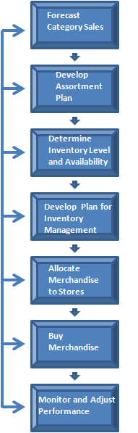
Merchandise Planning Process

Slide 75
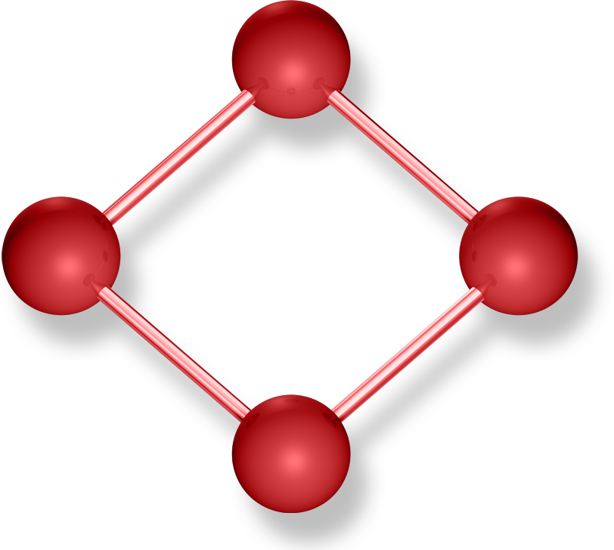
Factors that Impact Merchandise Management
Size of
Organization
Organization
Structure
Merchandise
to be Carried
Merchandise Management
Type of Store

Slide 76
Merchandise Manager’s Role
Planning
Directing
Coordinating
Controlling

Slide 77
Forecasting Process
Forecasting Steps:
Reviewing past sales
Analyzing the changes in economic conditions –
Analyzing changes in the sales potential
Analyzing changes in the marketing strategies of the retail organization and the competition
Creating the sales forecast

Slide 78
Forecasting Tools and Methods
Forecasts are of three general types:
Economic – These types of forecasts look at general business cycles such as the inflation rate, money supply, housing starts, etc.
Technological – Used to predict rate of technological progress and may impact the development of new products.
Demand forecasts – To predict sales of existing products and services.

Slide 79
Qualitative and Quantitative Approaches
The general types of qualitative forecasting are:
Jury of executive opinion - A group of opinions from high-level experts, sometimes assisted by statistical models.
Delphi method – Uses a panel of experts, where using an iterative process, continues until a group consensus is reached.
Sales force composite - Estimates from individual salespersons are reviewed for reasonableness, then aggregated.
Consumer Market Survey - Ask the customer.

Slide 80
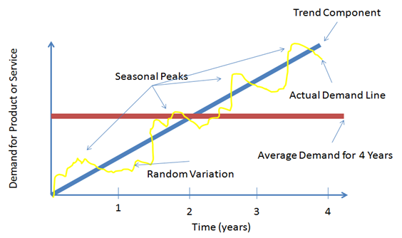
Qualitative and Quantitative Approaches
Quantitative Methods - The most basic method of quantitative forecasting is known as “time series” and uses a sequence of data points, measured typically at successive points in time spaced at uniform time intervals to predict future activity.

Slide 81
Qualitative and Quantitative Approaches
The most common quantitative time series models are:
Naive approach - Assumes demand in next period is the same as
demand in most recent period. Simple yet cost effective and efficient.
Moving average - a series of arithmetic means and is used if there is little or no trend as it tends to smooth historical data. Typically, recent data is averaged/
Weighted moving average - Used when some trend might be present as it treats older data usually less importantly. The weights used are based on experience and intuition and can minimize the smoothing effect if desired.
Exponential smoothing – A form of weighted moving average where weights decline exponentially with the most recent data weighted the most. It requires a smoothing constant (ranges from 0 to 1) which is subjectively chosen.

Slide 82
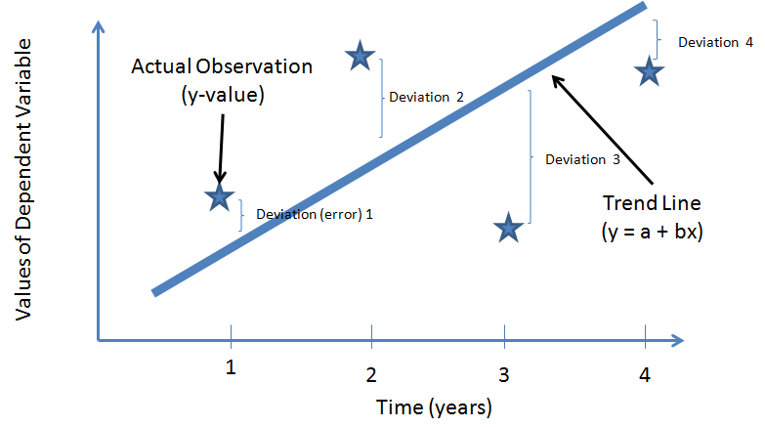
Qualitative and Quantitative Approaches
There are more sophisticated models known as “associative” models such as linear regression (also known as “least squared” method) and multiple regression analysis which use the relationship of an independent variable(s) (“x”) to predict a dependent variable (“y”). The reason it is called the least squares method is that the formula draws a “best fit” line through the historical data over time. That formula can then be used to predict future values of “y”.

Slide 83
Qualitative and Quantitative Approaches
If more than one independent variable is to be used, linear regression can be extended to multiple regression to accommodate several independent variables (ex: discounting, promotions, advertising, etc may all have an impact on sales to one degree or another). The formula for this is: y = a + b1x1 + b2x2 …(similar to the least squares formula, except with multiple independent variables).This is quite complex and generally done with the help of a computer.

Slide 84
Determining the Merchandise Requirement
The merchandise budget usually comprises five parts:
Sales plan - How much of each product needs to be sold by department, division or store (covered in the last section).
Stock support plan - Tells us how much inventory or stock is needed to achieve those sales.
Planned reductions - In case the product does not sell.
Planned purchase levels - The quantity of each product that needs to be procured from the market.
Gross margins – Profit margins that the department, division or store will contribute to the overall profitability of the company.

Slide 85
Methods of Inventory Planning
There are six general methods (and Key Performance Indicators) for planning inventory values:
Forward Weeks of Supply
Weeks of Supply
Stock to Sales Ratio
Sell Through Percent
Turn
Basic Stock

Slide 86
Methods of Inventory Planning
Another method (similar to FWOS) that retailers use, especially for fashion merchandise planning, is “open-to-buy” (OTB), which can be calculated in either units or dollars. OTB is the difference between how much inventory is needed and how much is actually available. This includes inventory on hand, in transit and any outstanding orders.

Slide 87

Merchandise Acquisition
Lean Buying -
  Negotiation
    Issues and Tips
    Processing the Order
    Collaboration in Product Development and Design

Slide 88
Merchandise and Assortment Planning Software
These systems may have a variety of functionality, including:
Merchandise financial planning – Used to manage financial targets and open-to-buy budgets.
Assortment and space planning – Automate the assortment planning process creating a more flexibility in planning in-depth assortments.
Price and markdown planning – Plan, forecast and analyze campaigns, promotions and events.
Allocation and replenishment – Improve order accuracy by helping to determine optimal demand-based allocation and replenishment needs.

Slide 89
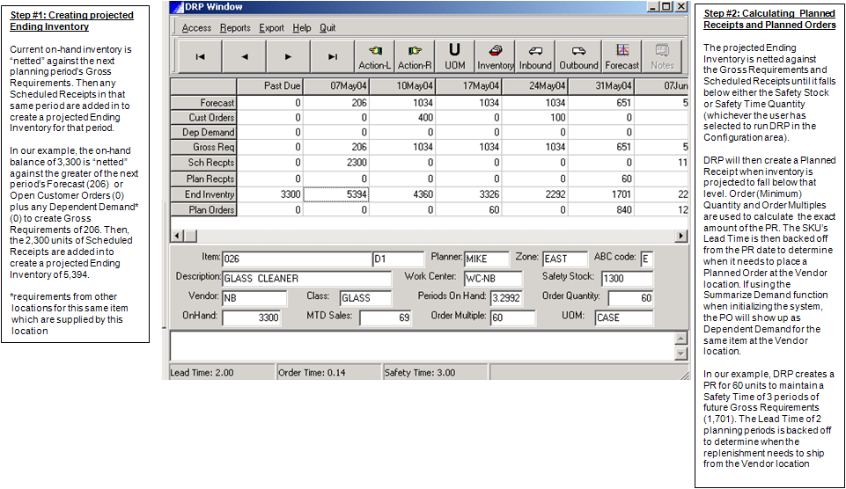
Distribution Requirements Planning (DRP) for Allocation and Replenishment
Sample DRP screen and description (PSI Planner for Windows™, Copyright 1998-2013)

Slide 90
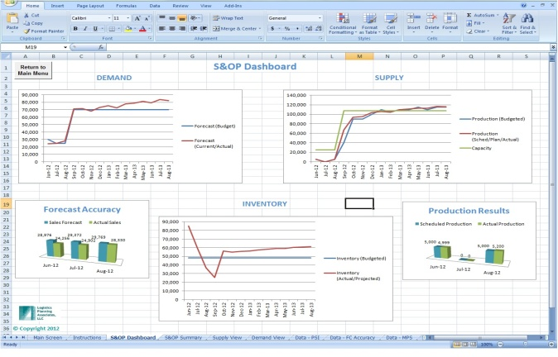
Sales and Operations Planning (S&OP; also known as “Integrated Business Planning”) in Retail and Wholesale
S&OP, also called aggregate planning, is a process in which executive level management regularly meets and reviews projections for demand, supply, and the resulting financial impact. S&OP is a decision-making process that makes certain that tactical plans in every business area coincide with the company’s business plan. The net result of the S&OP process is that a single operating plan is created that allocates company resources.

Slide 91
Being Lean: Store Operations Management

Slide 92
Store Operations
Degree of Interaction and
Customization
Low
Service Factory
(ex: warehouse and catalog store, restaurants)
Service Shop
(ex: hospitals and fine dining restaurants)
Degree of
Labor
Intensity
Low
High
Mass Service
(ex: commercial banking and retail)
Professional Service
(ex: general purpose law firm, private banking)
High
Service Process Matrix

Slide 93
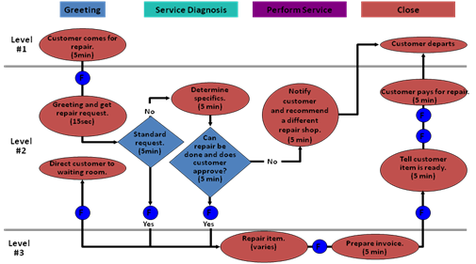
Service Blueprint
Service/Operations Blueprint

Slide 94
Management Responsibility
Cost control
Managing employees
Managing merchandise
Customer service

Slide 95
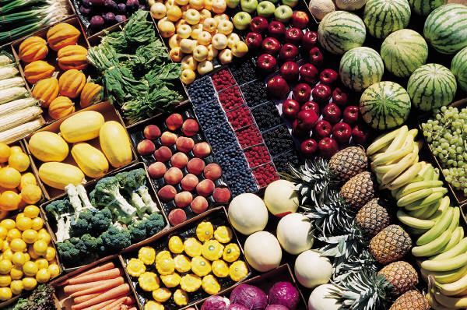
Store Design, Layout and Visual Merchandising

Slide 96
Store Design
Build loyalty – By meeting both customers’ utilitarian (i.e. the ability to enable customers to locate and purchase products in an efficient and timely manner with minimum hassle) and hedonistic (i.e. offering customers an entertaining and enjoyable shopping experience) needs.
Increase sales on visits - Large effect on which products customers buy, how long they stay in the store, and how much they spend during a visit.
Control cost - Control the cost of implementing the store design and maintain the store’s appearance. As a result, store design influences the shopping experience and thus sales, labor costs and inventory shrinkage.
Legal considerations - Protect people with disabilities from discrimination in employment, transportation, public accommodations, telecommunications and activities of state and local government
Design trade-offs – Trade off the ease of locating merchandise for planned purchases and give customers adequate space to shop with the exploration of the store, impulse purchases and the productivity of using limited space for merchandise

Slide 97
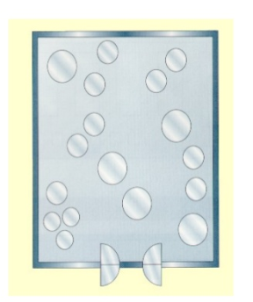
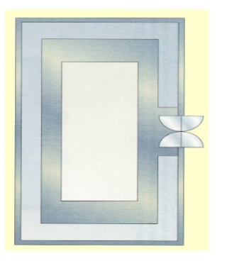
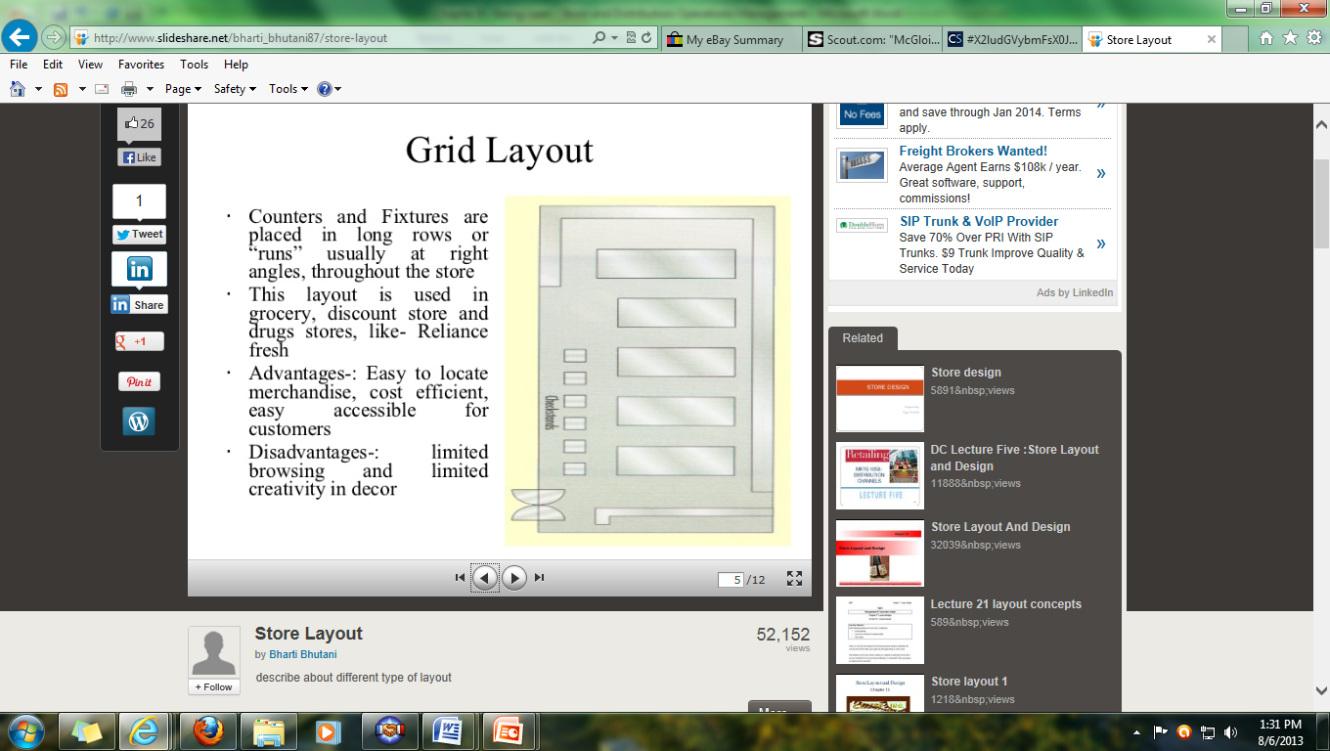
Store Layout
Grid Layout
Free flow or free form layout
Racetrack or Loop layout

Slide 98
Visual Merchandising
Visual merchandising is the development of floor plans and three-dimensional displays and signage to maximize sales.
Goods or services can be displayed to emphasize their features and benefits. Visual merchandising is utilized to attract, engage, and motivate the customer to purchase a product or service. This includes the selection and placement of signage, fixtures, counters, checkout, fitting rooms, displays, end caps, promotional aisles and fitting rooms.

Slide 99
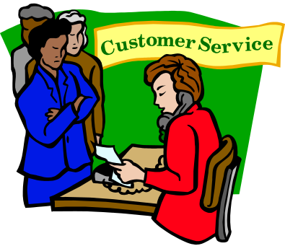
Customer Service
Customer service is the activities and programs that allow consumers to receive what they need or desire from your retail business.

Slide 100
Being Lean: Retail and Wholesale Distribution

Slide 101
Eight Wastes Applied to Warehouse Operations
1. Overproduction - Performing warehouse functions too soon or before an order has been placed (and excess inventory in a warehouse may already exist from over production or over purchasing).
2. Waiting – Can be applied to machines, materials, information, suppliers, customers, employees, and anything else that has the ability to sit and wait to be processed. As the saying goes, “time is money”, so a Lean operation should always try to reduce lead time.
3. Transportation – Unnecessary carrying and movement of material from one place to another is a major source of waste in materials handling.
4. Overprocessing – Having too much complexity or too many steps in your processes as well as over checking. Many warehouse processes are riddled with extra steps, checks and confusion.
5. Inventory - Excessive inventory is the result of overproduction and not only ties up the cash we have to run the business, but ties up our resources with the ineffective management of our surplus inventory. Also, poor inventory control (i.e. inventory inaccuracies) represents waste resulting in frequent stock-outs and late deliveries.
6. Movement or Motion - Occurs when work isn’t planned and lined up to be sequential to minimize the non-value added motion that frequently occurs in a warehouse
7. Defects or Errors - In warehousing, errors result in waste. To reduce the waste of rework and defects, a warehouse should build quality and standardization into their processes to prevent the passing on of errors.
8. Behavior - A frequently overlooked waste in warehousing is the waste of our employee’s knowledge. Employees can help to identify waste in their daily activity and be able to provide valuable ideas for improvement.

Slide 102

“Assembling” Orders
To radically improve this type of performance, warehouse orders should be looked at as being “assembled” in the most efficient manner, minimizing non-value activities including delays in receiving, putting away, picking, packing, and loading, as well poor picking paths, wasted motion, congestion, and poor equipment condition and availability.

Slide 103

Reverse Logistics
Reverse logistics is the process of moving goods from their typical final destination for the purpose of capturing value, or proper disposal.
In many cases, returns are a result of errors in shipment or product defects, a major form of waste in terms of Lean thinking. Reverse logistics can also be the result of a product needing servicing or a customer just not wanting an item as well as a whole host of other reasons such as processing returned merchandise due to damage, seasonal inventory, restock, salvage, recalls, and excess inventory, recycling programs, hazardous material programs, obsolete equipment disposition, and asset recovery.

Slide 104
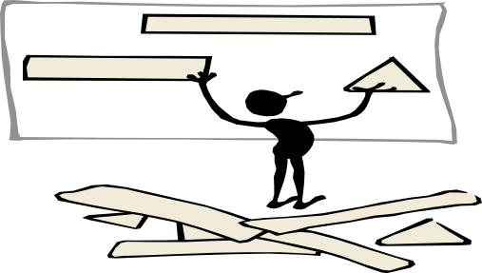
Value Stream Mapping in the Warehouse

Slide 105

Lean Enabling Technology in a Warehouse
A current state map may identify opportunities to reduce lead time and processing time in the warehouse, such as:
Decreased material handling time in order picking, putaway, and palletizing.
Issues with the strapping and metal detection machines.
Quicker truck loading time.
Less time spent checking inventory location and aging.
A future state map may identify improvements such as:
Redesigned pick and pack area that reduce wasted motion and errors.
Labeling and zoning of warehouse racks to reduce time spent looking for products.
Barcode case to track all cases and pallets in the warehouse.
Faster moving products placed on lower rack levels and closer to the shipping dock (known as “velocity slotting”).
Radio frequency bar code scanners used instead of paper and manual data entry and the implementation of a warehouse management system (WMS; discussed later in this chapter) to obtain real time inventory data and pick sequences to reduce order picking time and errors.
Increased employee cross training to improve productivity and reduce errors.

Slide 106
Being Lean: Getting Started – Lean Assessments and Value Stream Mapping

Slide 107
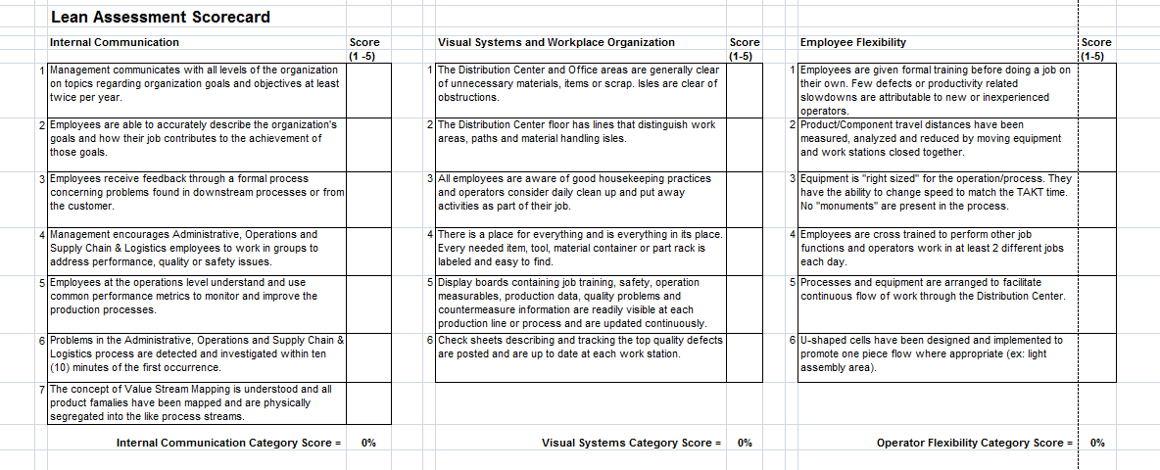
Lean Opportunity Assessment

Slide 108
Value Stream Mapping Defined
VSM is a team-based approach to mapping a value stream or process from beginning to end for an individual or family of products or services.
It visually (and numerically) breaks the process down into value-added and non-value-added steps from the viewpoint of the customer.
Typically, you should start at the customer end and work your way back to the supply end. It is best to have a diverse team of employees (no more than 8 to 10) who are typically supervisory and management level (although front-line employees will be involved in the mapping process as well).
It should typically take no longer than 2 days; 1 day for training and the current state map and the second day (usually a week or so later) to create the future state map. The entire process, including implementation, should be completed in less than 6 months at most (if not sooner).

Slide 109
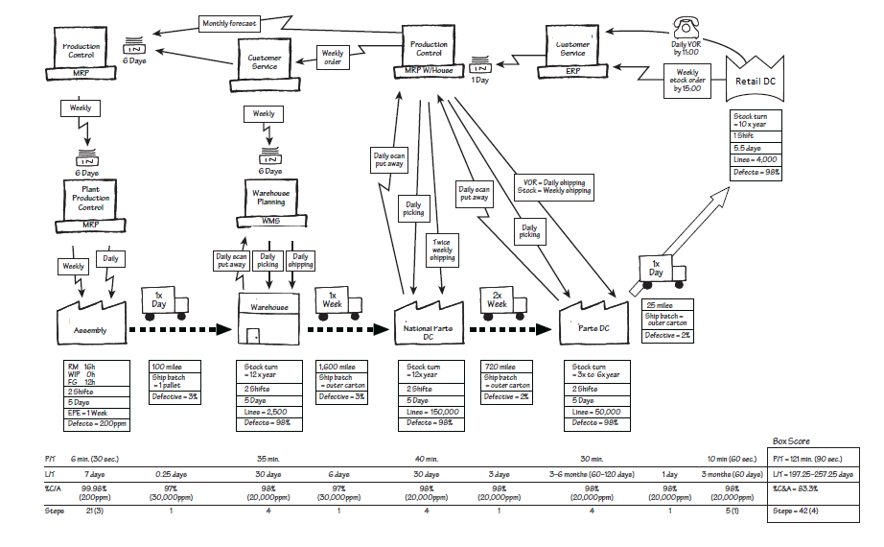
Current State Value Stream Map Example

Slide 110
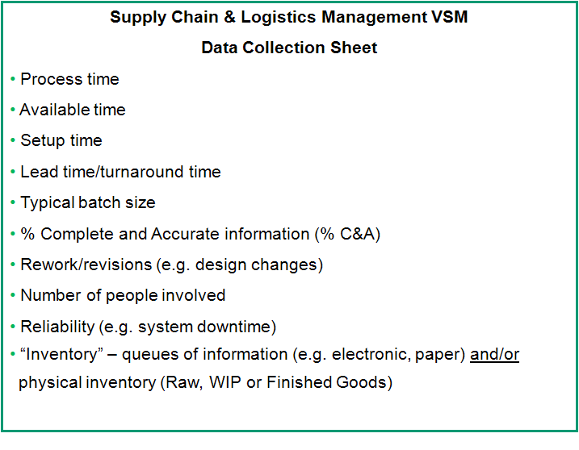
Supply Chain & Logistics VSM Data Collection Sheet
Retail and Wholesale Value Stream Mapping

Slide 111
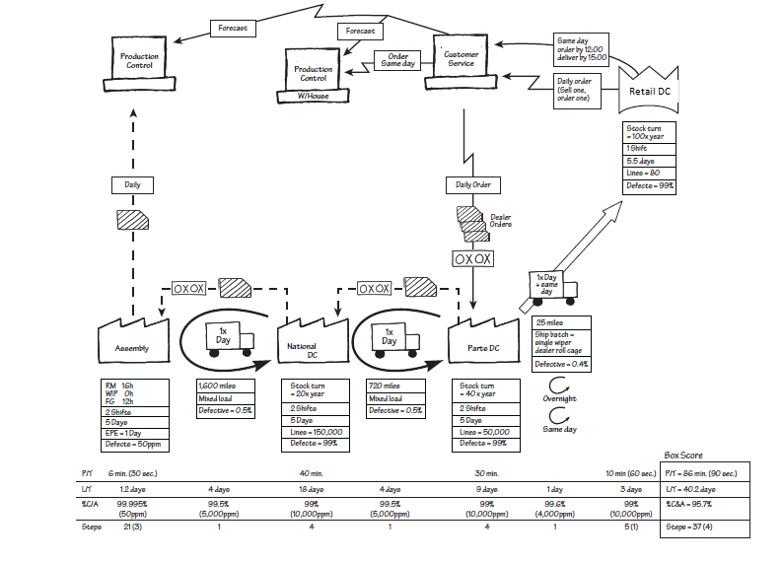
Future State Value Stream Map Example

Slide 112
Waste in a Retail Store
In a retail store, it is helpful to think of waste in terms of the five points of transition for a customer (i.e. enter, seek, find, select and transact). The types of waste to look for in each are:
FivePoints/ Wastes | Motion | Waiting | Excess Information | Excess Inventory | Defects/ Errors | Over-processing | Transportation
Enter | X | X | X
Seek | X |  | X | X | X
Find | X | X |  |  | X | X
Select | X |  | X |  | X |  | X
Transact | X | X |  |  | X | X

Slide 113
Conceptual Longer Term Future State Map
1
Manufacturer
2
3
4
5
6
Retail
Back of
Store
Retail
Store
Distributor
Natl’l DC
Retail
RDC
1
Manufacturer
2
3
Retail
Back of
Store
Retail
Store
Distributor
Nat’l DC
Distributor
Cross Dock
30% Lower Logistics Costs

Slide 114
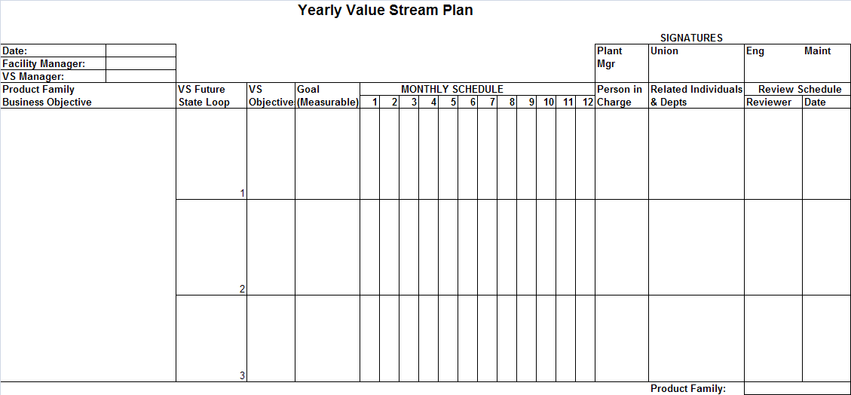
Value Stream Plan

Slide 115

Lean Teams

Slide 116
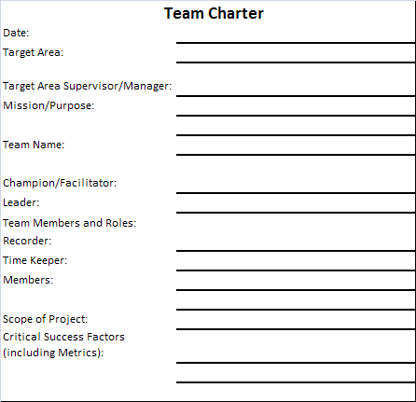
Team Charter

Slide 117
Kaizen Events
Kaizen is loosely translated (or commonly known) to mean continuous improvement. So a kaizen event is a team-based continuous improvement project. The goal of a kaizen event is process improvement through the elimination of waste at all levels of the process. Typically, prior to the actual event, there is a period of training in general Lean concepts and applications, as well as additional training in specific tools, such as setup reduction, work cells, etc.

Slide 118
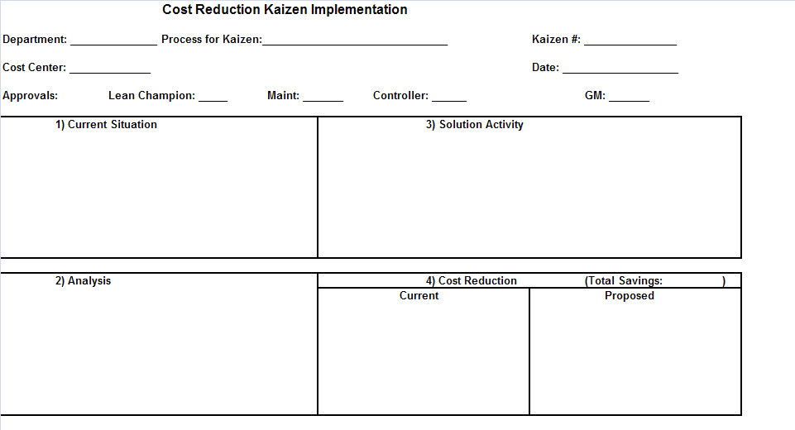
Cost Reduction Kaizen Implementation Form

Slide 119
Staying Lean: Leadership, Culture, Teams and Training

Slide 120
Organizational Culture
The values and behaviors that contribute to the unique social and psychological environment of an organization and includes an organization's expectations, experiences, philosophy, and values that hold it together, and is expressed in its self-image, inner workings, interactions with the outside world, and future expectations. It is based on shared attitudes, beliefs, customs, and written and unwritten rules that have been developed over time and are considered valid

Slide 121
Lean Culture
An organizational environment in which values and behaviors are aligned with the guiding principles of Lean thinking.

Slide 122
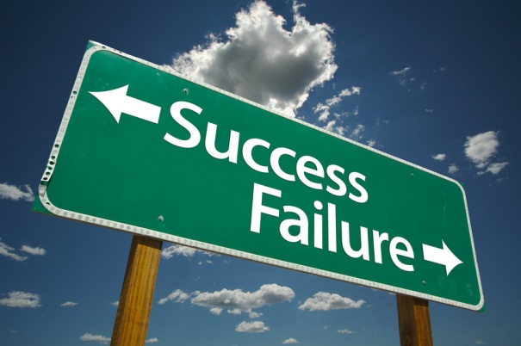
Key Success Factors
Management Leadership and Support
Lean Training
Lean Infrastructure

Slide 123

Teamwork and Lean
Teamwork is fundamental to compete in today’s global environment in general, and to Lean in particular and should be part of any Lean retail strategy

Slide 124
Elements Needed for Sustainability & Success
1. Readiness Check
2. Change & Accountable Leadership Structure
3. Learning System
4. Best Practice Tool & Tactic Deployment
5. Continuous Improvement & Sustainment
Leadership Model
Leadership Model

Slide 125
Becoming Even Leaner: Partnering, Outsourcing (Private Label), Import (Logistics), Technology, (Lean) Six Sigma and System

Slide 126

Partnering
There are many ways that manufacturers/suppliers, 3PL’s, retailers and wholesalers collaborate with each other including VMI, QR, ECR and CPFR

Slide 127
Outsourcing (Private Labeling)
Private label products or services are manufactured or provided by one company under another company's brand and are usually lower cost alternatives to regional, national or international brands.
Private labeling can have many benefits to the retailer or wholesaler such as:
Greater control of production, marketing, distribution and profits of the product or service.
Cost and time savings due to a contract manufacturer’s expertise in ingredient costs and trends.
Partnering with private label manufacturers who have R&D and marketing teams that can work with brand owners on packaging, design and sales strategy.
Create a personalized image which may lead to higher customer loyalty.
Take advantage of the general trend in customer's changing preference towards private label products (once considered a low cost alternative, many store brands are now thought of as “on par” with name brands).

Slide 128
Import (Logistics)
Importing products has enabled retailers and wholesalers to offer lower prices on merchandise, but it has also significantly complicated our businesses from a supply chain & logistics standpoint . There are an extraordinary number of parties involved in the process including customs, freight forwarders, banks, ports, transportation (rail, truck and ocean), etc.
Can use Lean tools such as Value Stream Mapping to analyze and improve the processes.

Slide 129

Technology
Partnering
There is an abundance of relatively low cost technology that can connect supplier/manufacturers, 3PL’s, wholesalers and retailers via the internet or EDI.
Marketing
Retail marketers now have access to vast amounts of data to find, target and retain customers. There is now technology available to perform the analytics to convert this data to real, usable information.

Slide 130

(Lean) Six Sigma
Six Sigma attempts to improve the quality of process outputs by identifying and removing the causes of defects (errors) and minimizing variability in manufacturing and business processes.
It uses a set of quality management methods, including many statistical methods, and creates a special infrastructure of people within an organization ("Champions", "Black Belts", "Green Belts", "Yellow Belts", etc.) who are experts in the methods.
Six Sigma can be thought of as complementary to Lean, as Lean looks at an entire value stream from customer to supplier and Six Sigma tends to look at an individual process’ variability. As a result, there is now “Lean Six Sigma”.

Slide 131
A Lean System
TPS
JUST
IN TIME
JIDOKA
HUMAN
DEVELOPMENT
STANDARDIZED HEIJUNKA KAIZEN
WORK
Toyota “House of Lean”

Slide 132
Critical Thinking and Continuous Improvement: Methodology, Education, Training and Analytics

Slide 133
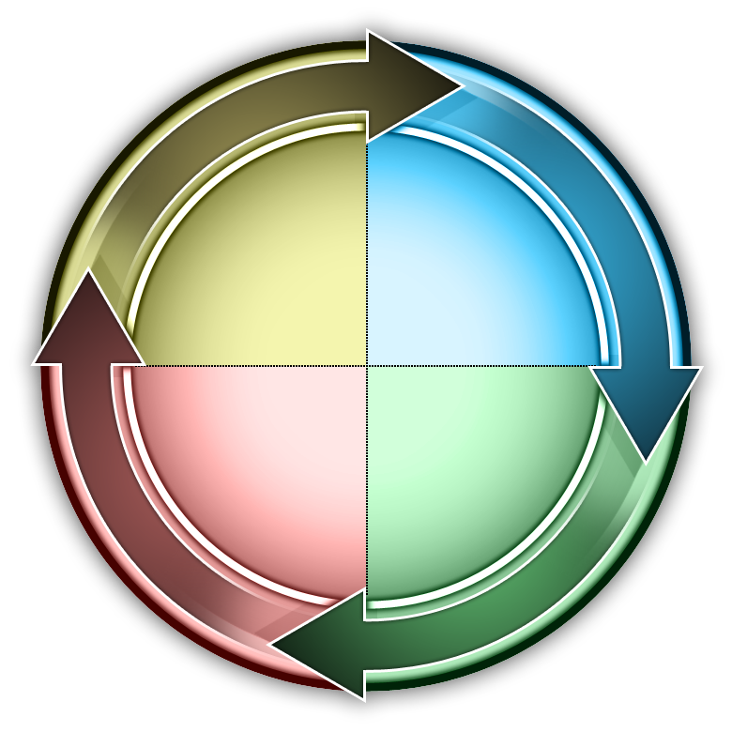
Methodology or Approach
instruct
innovate
improve
implement
4i’s Methodology

Slide 134

Training Methods
  Presentation Method
  Hands-On Method
  Group Building Method
  Individual Learning

Slide 135

Training – Tools and Tips
Games
Handouts (forms and exercises
Language barrier

Slide 136
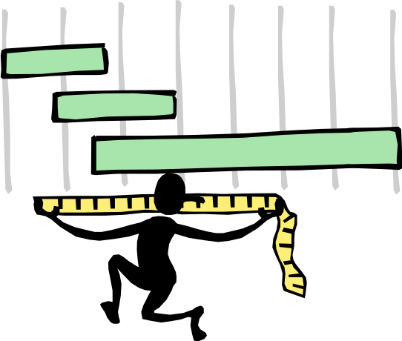
Measuring Success

Slide 137
Defining and Measuring Success: Measurements and Current Statistics

Slide 138

Key Performance Indicators (KPI)
Key Performance Indicators (KPI’s) help an organization define and measure progress toward organizational goals. These goals and metrics can include Lean indicators that are often dispersed in various financial, marketing and operational areas.

Slide 139
KPI’s and Metrics in Retail
Conversion Rate
Sales per square foot
Average purchase value
Cost of goods sold
Online purchases vs. in-store purchases
Incremental sales
Customer Experience
Customer Retention
Percentage of out of stock items
Inventory to Sales Ratio

Slide 140
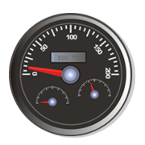
Dashboards to Display and Control Metrics
A very common way to measure, analyze and manage supply chain performance is with the use of a dashboard. The dashboard can be as simple as data manually collected and put into a spreadsheet with some graphs, to a more automated, visually pleasing dashboard generated by an ERP system. A dashboard helps in decision making by visually displaying in real time (or close to it), leading and lagging indicators in a retail and wholesale process perspective.

Slide 141
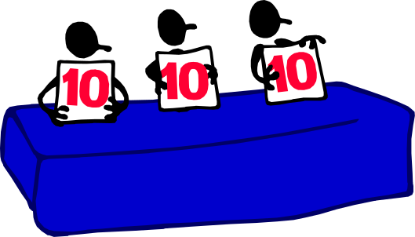
Balanced Scorecard
A balanced scorecard is a strategic planning and management system that is often used by organizations to align business activities with the vision and strategy of the organization, improve internal and external communications, and monitor organization performance against strategic goals.

Slide 142
The Road Ahead: Thoughts and Suggestions on the Future of Lean in Retail, Wholesale

Slide 143
People, Process and Technology views
Effective to think of both the current and future state of an organization in terms of a combination of people, process and technology

Slide 144

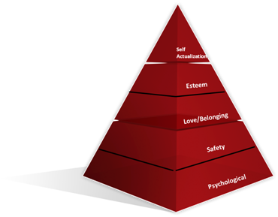
People
Maslow’s Hierarchy of Needs

Slide 145

People
The Job Design Continuum

Slide 146

Process

Slide 147

Technology

Slide 148

Retail Trends
Self serve
Blurring of sectors
High speed retail
RFID
Mass customization
Social networks
Showrooming
Store-size rationalization
Near-field communication
Growth in order fulfillment from stores

Slide 149
Wholesale Distribution Trends
E-commerce is gaining critical mass
Mobile is becoming a ‘game-changer’
Analytics is taking center stage
Distributors are facing a competitive shift
Vending is continuing explosive growth
More distributors are going global

Slide 150

Wrap Up

